Slide 1


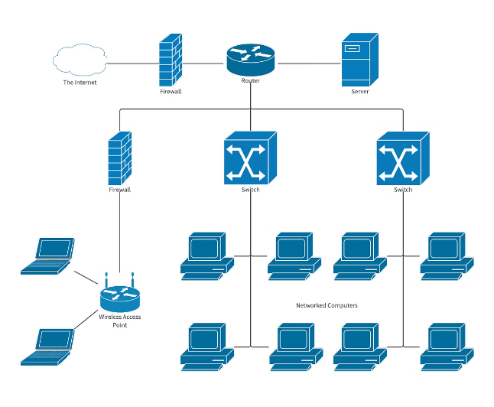
Networking Layer of the OSI Model
The Networking Layer, also known as Layer 3 in the Open Systems Interconnection (OSI) model, is responsible for connecting devices across networks. It acts as the middleman, ensuring data packets travel from one device to another, even if those devices are on different networks. It's like a postal service for digital information, handling the address and delivery of packets.

Slide 2
IP Address and Masking
An IP address is a unique identifier for a device on a network. It's like a street address for your computer, allowing other devices to locate and communicate with it. IP addresses come in two flavors: IPv4 and IPv6. IPv4 addresses are the older format, using 32 bits to represent a device's location. IPv6, a newer and more expansive format, uses 128 bits, allowing for a significantly larger number of addresses.
Subnet masks are used to divide a large network into smaller subnetworks, allowing for more efficient use of IP addresses and better control over network traffic. It's like dividing a city into neighborhoods, each with its own unique address range. Imagine you live in a large city with only one postcode. It would be difficult to deliver mail efficiently. By using a subnet mask, we divide the large network into smaller subnetworks, each with its own unique address range.
IP Address
Subnet Mask
A unique identifier for a device on a network. It's like a street address for your computer, allowing other devices to locate and communicate with it.
A network mask that divides a large network into smaller subnetworks. It helps with efficient use of IP addresses and better control over network traffic.

Slide 3

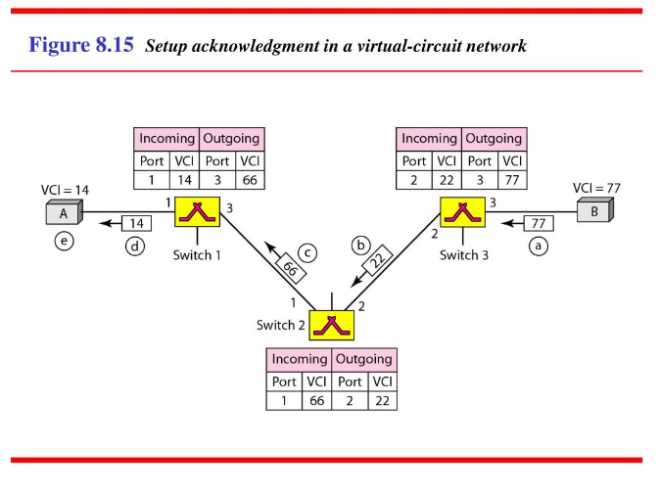
Virtual Circuits vs. Datagram Circuits
Think of a virtual circuit like a dedicated phone line. When you make a call, a connection is established between your phone and the receiver's phone, allowing for continuous communication. This is similar to a virtual circuit where a path is established between two devices for the entire duration of a communication session. Data packets flow in sequence along this dedicated path, ensuring reliable delivery. The advantages of virtual circuits include guaranteed delivery, low overhead, and the ability to prioritize traffic.
A datagram circuit, on the other hand, is like sending letters through the postal service. Each packet travels independently, without a predetermined path. The receiver assembles the packets in the correct order once they arrive. This approach offers flexibility, as each packet can take different routes, but may not be as reliable. It's a more efficient approach when dealing with large amounts of data, where the order of arrival isn't crucial.
Virtual Circuit
Datagram Circuit
A dedicated path is established between two devices for the entire duration of a communication session. Data packets flow in sequence along this dedicated path, ensuring reliable delivery.
Each packet travels independently, without a predetermined path. The receiver assembles the packets in the correct order once they arrive.

Slide 4





Distance Vector Routing
Distance Vector Routing (DVR) is like a gossiping network of neighbors. Each router shares its distance to all other routers on the network with its immediate neighbors. This information is then passed on to other neighbors, forming a web of information about the network's topology.
Routers update their routing tables based on the information received from their neighbors, calculating the shortest path to each destination based on the hop count (the number of routers a packet needs to traverse). While this approach is simple to implement, it can be slow to react to changes in the network and can suffer from instability if there are loops in the network. It's like a game of telephone where information can get distorted as it's passed along.
Router A
Router B
Router C
Router D
Shares its distance to other routers with its neighbors.
Receives distance information from Router A and updates its routing table.
Receives distance information from Router B and updates its routing table.
Receives distance information from Router C and updates its routing table.

Slide 5

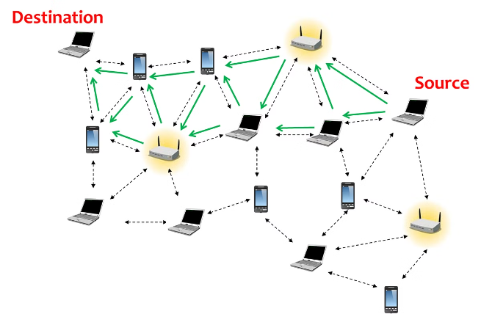
Link State Routing
Link State Routing (LSR) is like a map. Each router builds a complete map of the network, including the connection between every pair of routers and the associated cost (e.g., latency or bandwidth) for each link. This map is then shared with all other routers on the network.
Once a router has the complete map, it can calculate the shortest path to any destination using a shortest-path algorithm, such as Dijkstra's algorithm. LSR is more robust than DVR because it avoids loops and reacts more quickly to changes in the network. It's like having a GPS system that always knows the shortest route based on real-time traffic conditions.
Distance Vector Routing
Link State Routing
Shares information with neighbors
Shares complete network map
Slower to adapt to changes
Faster to adapt to changes
Prone to loops
Avoids loops

Slide 6

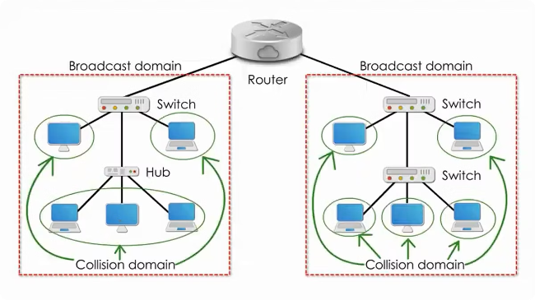
Broadcast Routing
Broadcast Routing is like sending a postcard to every address in a city. When a device wants to send a message to all other devices on the network, it uses a broadcast address. This address ensures that the message reaches every device connected to the network. It's a simple and effective way to send information to everyone, but it can lead to network congestion and inefficiency, especially in larger networks.
Broadcast routing is used in situations where all devices on the network need to receive the same information, such as network configuration updates or security alerts. However, it's not suitable for sending large amounts of data or for applications that require a high level of security.
1
Benefits
2
Drawbacks
Simple to implement.
Can lead to network congestion and inefficiency.

Slide 7

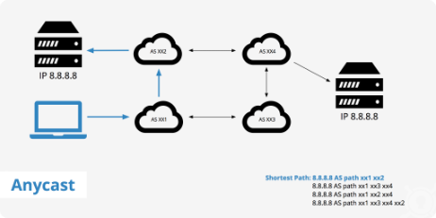



Anycast Routing
Anycast Routing is like having a phone number that can be answered by any of several different offices. A device can send a message to an anycast address, and the message will be delivered to the closest device that is associated with that address. This is useful for distributing traffic across multiple servers, ensuring that users always connect to the closest and most responsive server.
Imagine you have a website hosted on multiple servers across the globe. If you use anycast routing, when a user requests your website, they will be directed to the server closest to their location, ensuring faster loading times and a better user experience. Anycast routing is a powerful tool for distributing traffic and improving performance.
Global Reach
Improved Performance
High Availability
Distributes traffic across multiple servers located globally.
Directs users to the closest and most responsive server.
Provides redundancy and ensures service availability even if one or more servers go down.

Slide 8

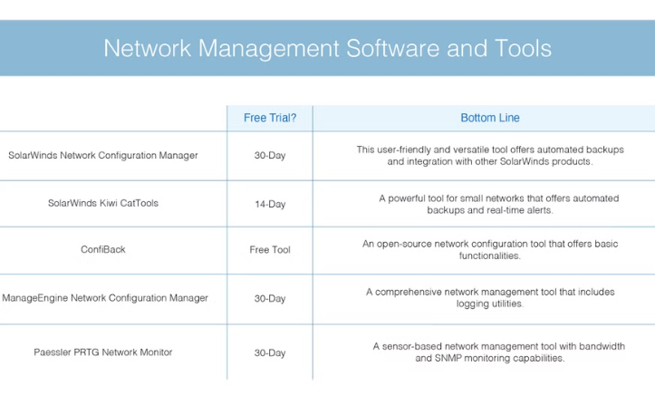
Multicast Routing
Multicast Routing is like sending a newsletter to a specific group of subscribers. It allows a single device to send a message to a group of devices, without having to send the same message to each individual device separately. This is more efficient than sending a broadcast message, as it reduces network traffic and conserves bandwidth.
Multicast routing is used in applications like video conferencing, where multiple participants need to receive the same video stream. It's also used in network management applications where a device needs to send the same configuration information to multiple devices on the network.
Video Conferencing
Network Management
Allows multiple participants to receive the same video stream without having to send the same message to each individual device separately.
Allows a device to send the same configuration information to multiple devices on the network.

Slide 9

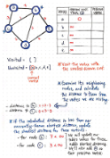
Shortest Path Algorithm
Shortest path algorithms are the brain behind efficient routing. They are used to calculate the shortest path between two points in a network, taking into account the cost of each link (e.g., latency or bandwidth). Some popular shortest path algorithms include Dijkstra's algorithm, Bellman-Ford algorithm, and Floyd-Warshall algorithm.
Dijkstra's algorithm is commonly used for finding the shortest path in a network with non-negative edge weights. It starts at a source node and iteratively explores the network, always choosing the edge with the smallest weight that leads to an unvisited node. This algorithm is used in a wide range of applications, from GPS navigation to network routing.
Step 3
Step 1
The algorithm continues to explore the network, choosing the node with the smallest tentative distance and updating the tentative distances to its neighbors.
The algorithm starts at the source node and assigns a tentative distance of 0 to it.
1
2
3
4
Step 2
Step 4
The algorithm then explores the neighbors of the source node, updating the tentative distances to those nodes.
The algorithm continues until all nodes have been visited and the shortest path from the source node to all other nodes has been found.

Slide 10

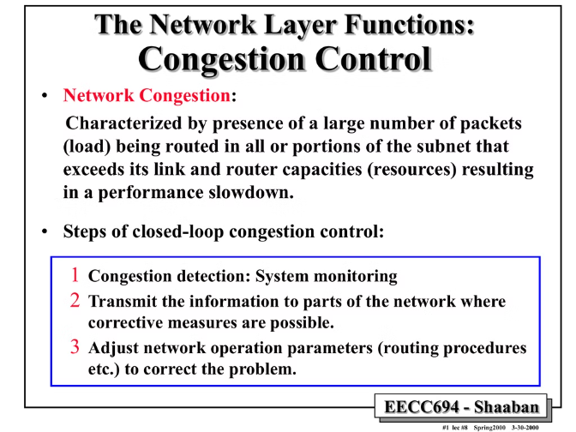
Congestion Control Algorithm
Congestion control is the process of managing network traffic flow to prevent network congestion and ensure efficient and reliable data delivery. Congestion control algorithms are used to regulate the rate at which data is sent over the network, preventing the network from becoming overloaded and ensuring a smooth flow of data.
There are various congestion control algorithms, each with its own strengths and weaknesses. Some common algorithms include TCP's slow start and congestion avoidance, as well as algorithms that dynamically adjust transmission rates based on network conditions.
These algorithms are like traffic lights, ensuring that network traffic flows smoothly and avoids bottlenecks. When congestion is detected, these algorithms can slow down traffic flow, preventing the network from becoming overloaded.
1
Slow Start
2
Congestion Avoidance
Gradually increases the transmission rate until congestion is detected.
Maintains the transmission rate at a level that avoids congestion.
3
Fast Retransmit
4
Fast Recovery
Quickly retransmits lost packets to minimize the impact of congestion.
Quickly recovers from congestion by adjusting the transmission rate.

